Slide 1
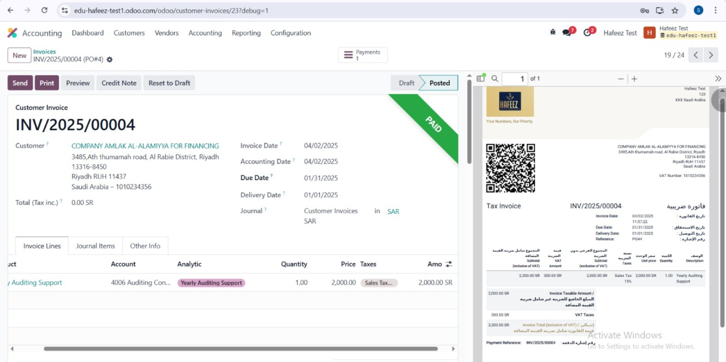
Customer Invoice

Slide 2
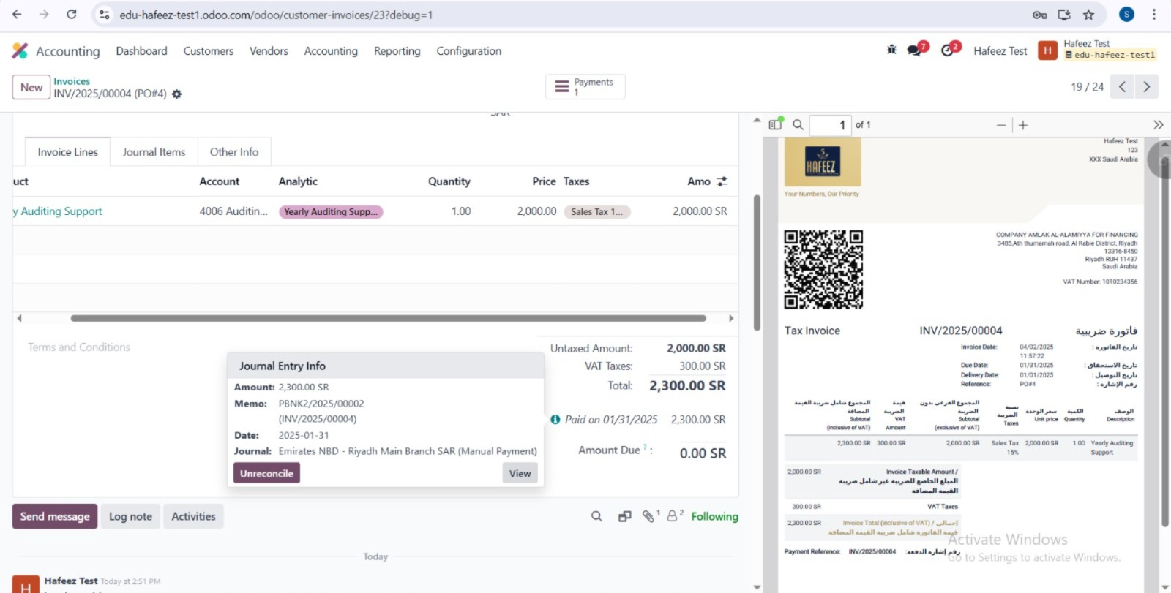
Customer Payments
Register Payment directly from the Customer Invoice

Slide 3
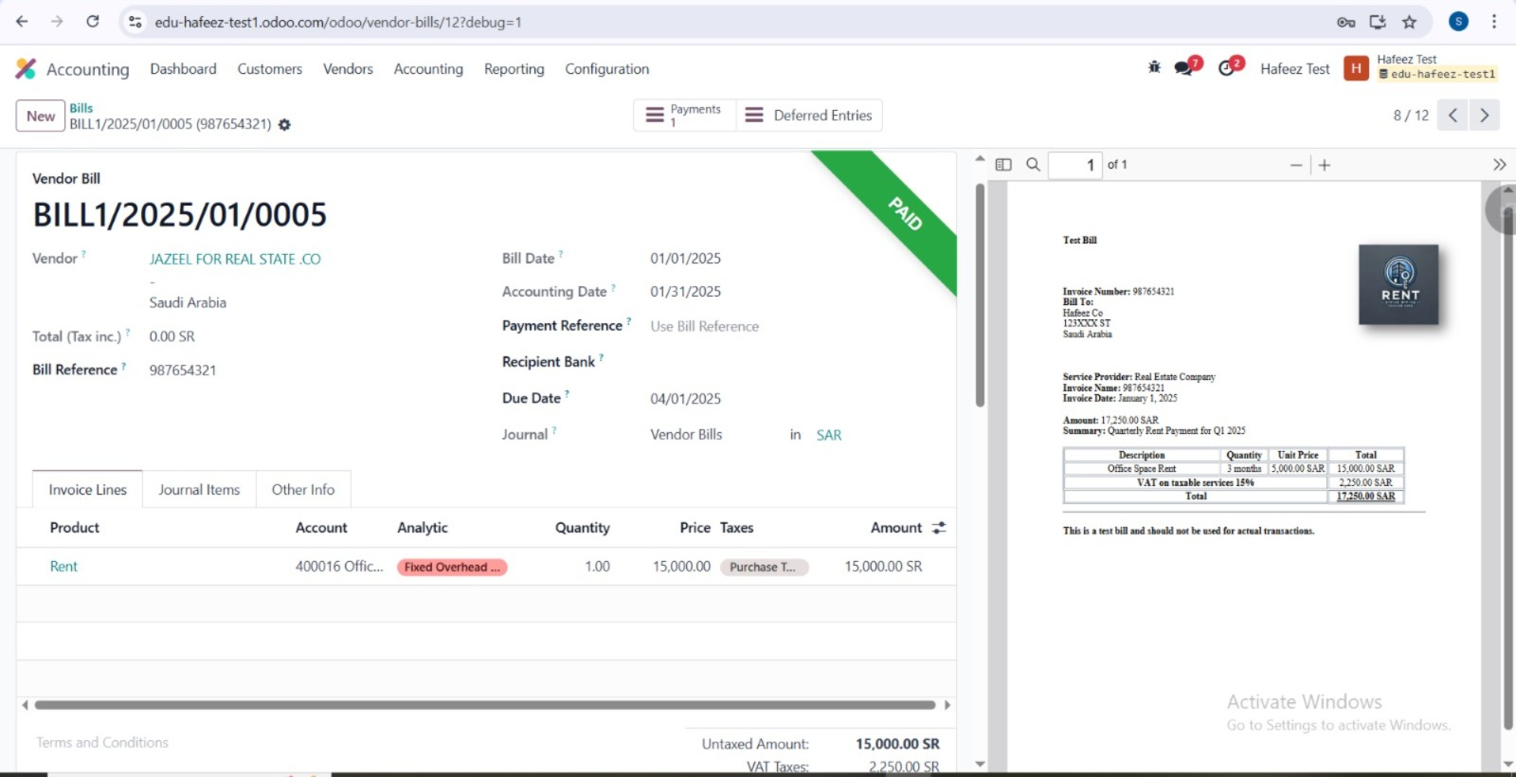
Vendor Bill

Slide 4
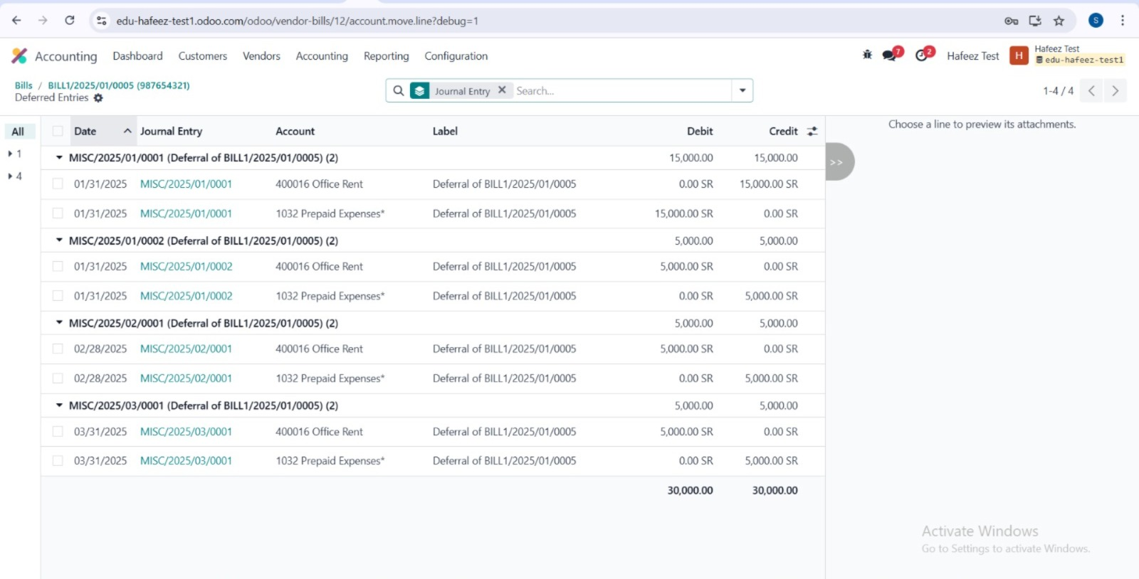
Deferred Expenses
Automatic Tracking

Slide 5
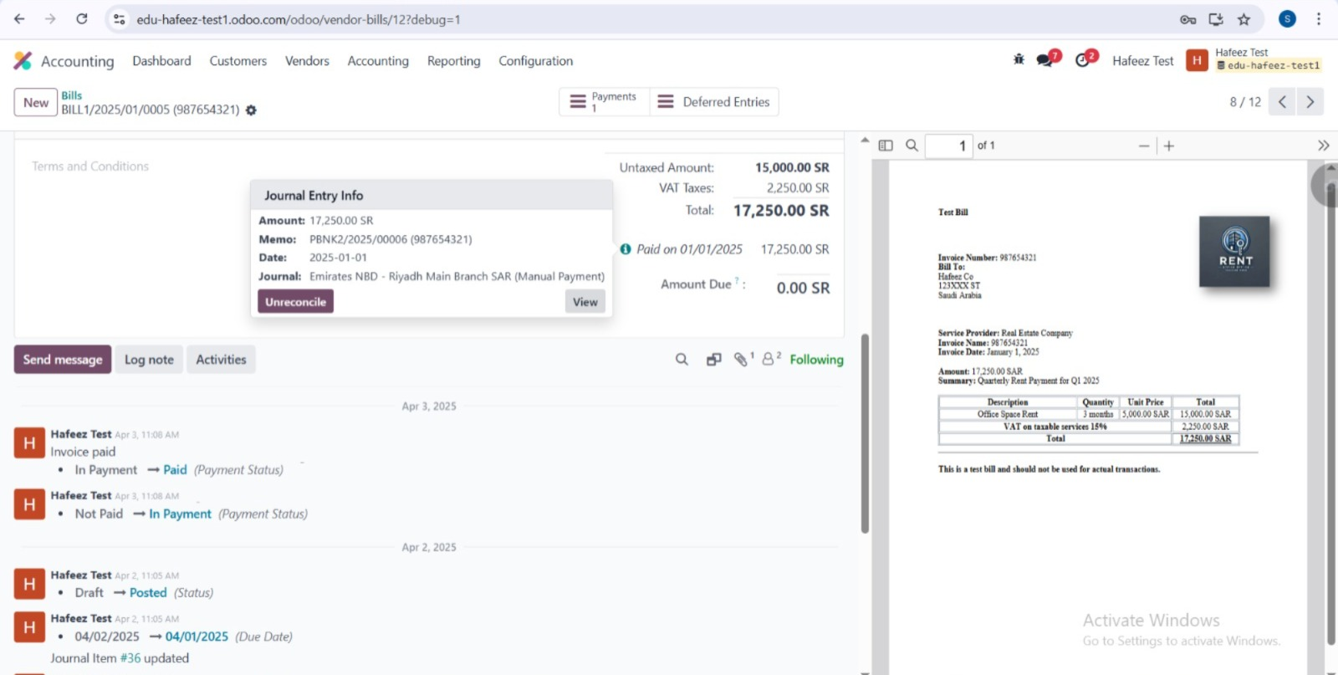
Vendor Payments
Register Payment directly from the Vendor Bill

Slide 6
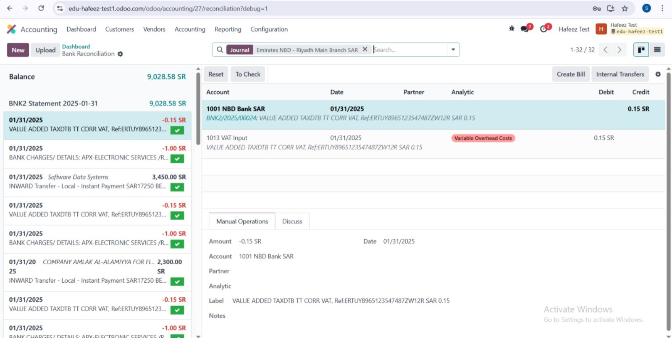
Bank Reconciliation
Match bank statement lines with Customer In and Vendor Out payments based on actual operations

Slide 7
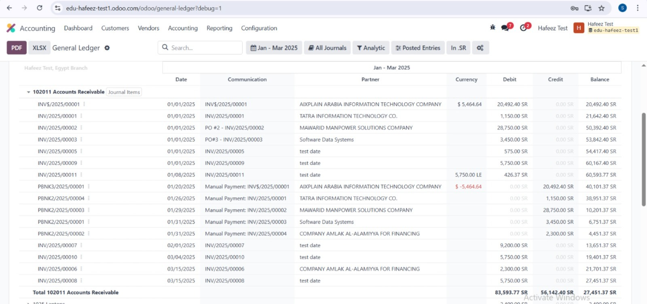
General Ledger Report

Slide 8
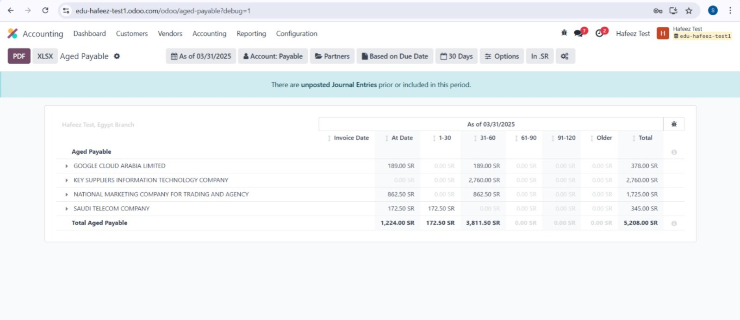
Aged Payable & Receivable Reort

Slide 9
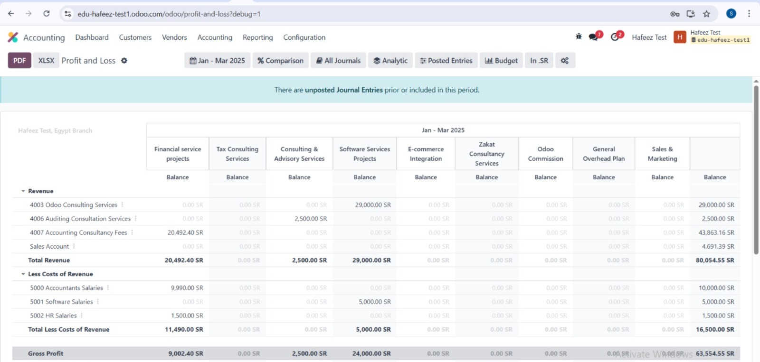
Track your period profit and check per-project performance

Slide 10
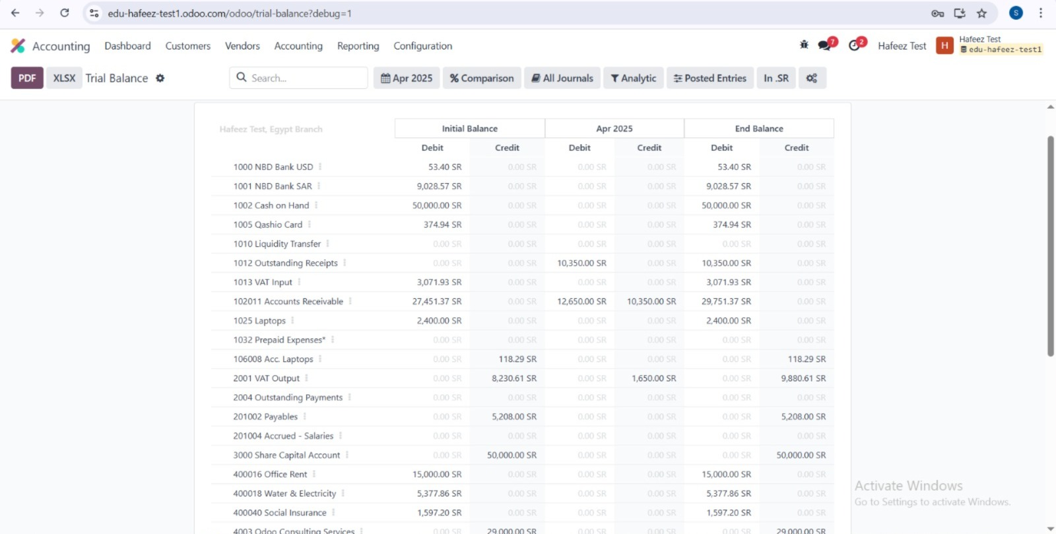
Trial Balance
Your Ledger’s Reality Check!

